Slide 1
2024 Fleet Sustainment Data Science Internship Project
Jeff Carswell
Jason Chen
Rica Esquivel

Slide 2
Presentation Overview
Executive Summary
Preparing for Predictive Modeling
Data cleaning, Integration, Exploratory Data Analysis (EDA)
Predictive modeling and Dashboards
Takeaway
Skills/techniques learned

Slide 3
Executive Summary
HVAC Systems are vital to the mission of Navy weapons platforms
Crew Comfort and Well-Being
Operational Efficiency
Safety
Operational Readiness
Energy Efficiency
The current maintenance process faces challenges such as:
Inefficient resource allocation
Unexpected delays
High volume of unstructured narrative data
Minimal visualization support
Objective
Use data-driven models and visualizations to help planners and maintenance personnel improve maintenance efficiency and optimize supply allocation/usage.
Deliverables
Machine learning models to predict maintenance duration
User-friendly, interactive dashboard
Business Implications
Optimized systems from data-driven solutions
Better confidence and trust from our navy customers

Slide 4
Preparing for Predictive Modeling
Data Wrangling and Cleaning
Dataset Integration
Feature Engineering
Data Analysis

Slide 5


The Datasets
~47,000 job records
CVN68-78
11/01/2017 - 06/16/2022
AKA maintenance duration
Hours expended by personnel to complete the job
Problem Description
~1,900 distinct in dataset
Jobs Data
Job Sequence | CSMP Narrative | Equipment Nomenclature | Location | Deferred Narrative | Total Ship Force Man Hours | Days Open | Date Maintenance Action | Date Closing | Ship
40785851 | 11FD SENSOR INOP | IC CKT 11FD-FLOA | 8-200-5-E | owc discovered during normal operations that 11fd sensor … is inop and needs to be replaced owc to order receive and replace 11fd sensor | 90.0 | 5 | 2022-03-04 | 2022-03-09 | CVN68
40139143 | REPLACE DIRTY FILTER IN FCU | VENT NONMCH PRP | 3-165-4-L | during pms … filter was dirty and needed to be replaced … owc will replace … once filters are received from supply | 3.0 | 15 | 2021-07-27 | 2021-08-11 | CVN76
Associated Supply Data
Hours until parts arrived
Type of supply
Job Sequence | Demand Date | Issue Date | CWT Hours | NIIN Nomenclature | Quantity | Price | Total Material Cost
40785851 | 2022-03-04 | 2022-03-09 2022-05-08 2022-04-22 | 122.0 1556.16 1171.42 | SWITCH,LIQUID LEVEL SWITCH,LIQUID LEVEL SWITCH,LIQUID LEVEL | 1 19 1 | 138.38 2629.22 138.38 | 2905.98
40139143 | 2021-07-27 | 2021-08-11 | 356.77 | FILTER ELEMENT,AIR | 18 | 25.32 | 455.76
Sample job records with a select number of columns that are most relevant to the machine learning (ML) techniques used.

Slide 6
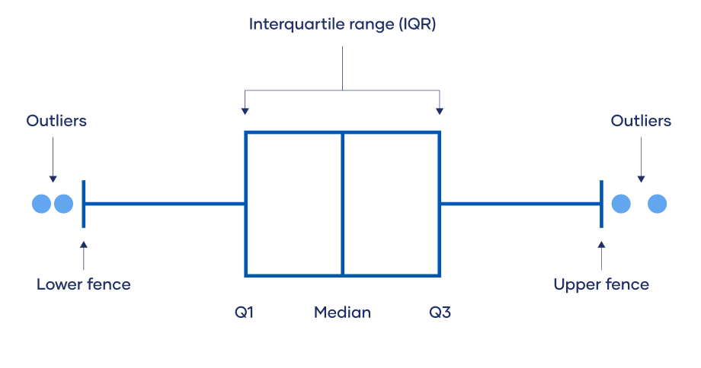
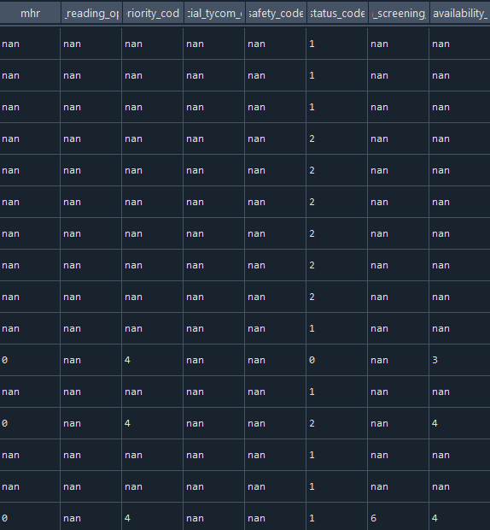
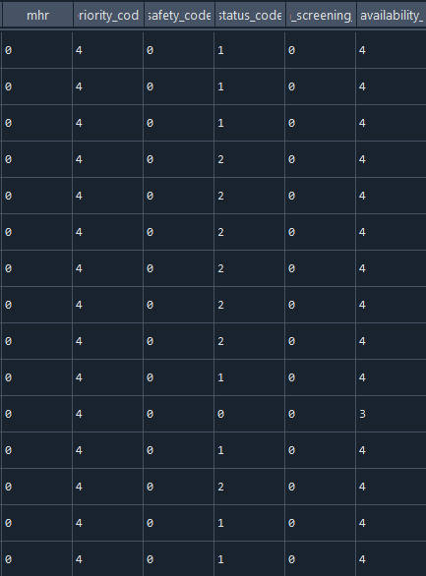
Data Wrangling & Cleaning
Missing Values
Removed 22 columns (All NAs or unimodal value)
Remaining 66 columns NAs
Mode, Median, 'Unknown'
Outliers
Interquartile Range
Negative hours/days
Mode, Median, Zero
Data Familiarization
Ships' Maintenance and Material Management database/data records
Before Cleaning
After Cleaning
Natural Language Processing
Tokenization
"The cat sat on the mat" becomes ["The", "cat", "sat", "on", "the", "mat"]
Helps computer look at each word individually
Lemmatization
"running" becomes "run", "better" becomes "good"
Remove Stop Words
Removing words that do not contribute much value like "the", "is", "and"

Slide 7
Data Wrangling & Cleaning- Continued
How should missing values be handled?
General Approach:
Missing values in categorical columns are replaced by the category that occurs most in that column
Missing values in numerical columns are replaced by the median value of that column. Mean is not used due to outliers.
Missing values in narrative columns are replaced by the phrase 'Unknown'
Before Cleaning
After Cleaning

Slide 8
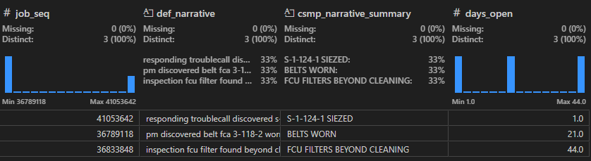
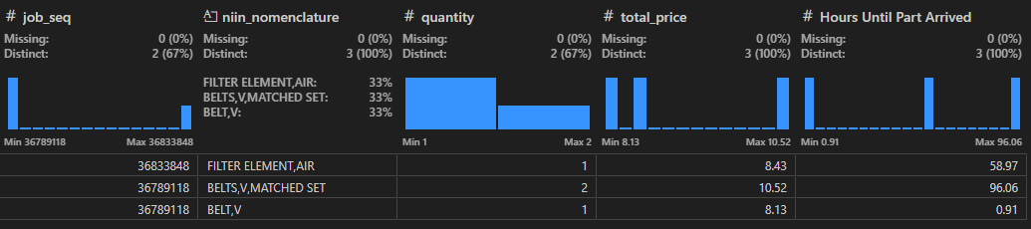
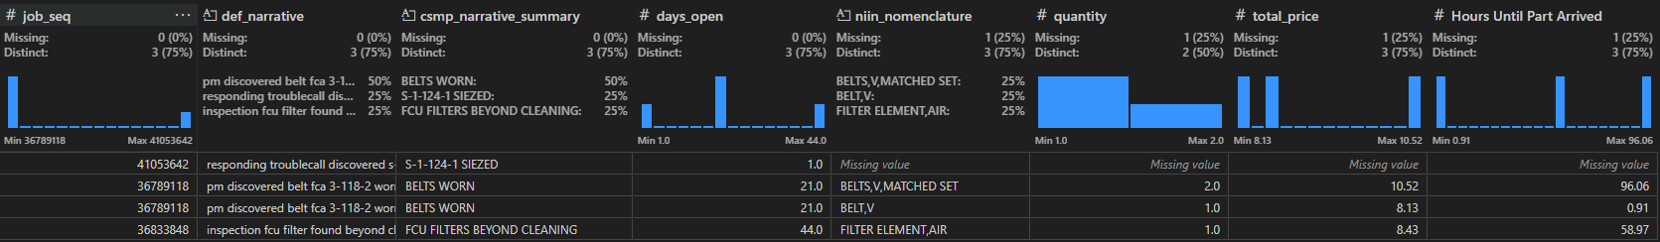
Data Integration
Jobs Data
Supply Data
Comprehensive View for a Maintenance Action

Slide 9
Feature Engineering
Creating new features that could provide additional value to the model building process
Applications:
total price = quantity X unit price
Days Until All Parts Required for Job Arrived = (group by(job sequence), max(Days Until Part Arrived))

Slide 10
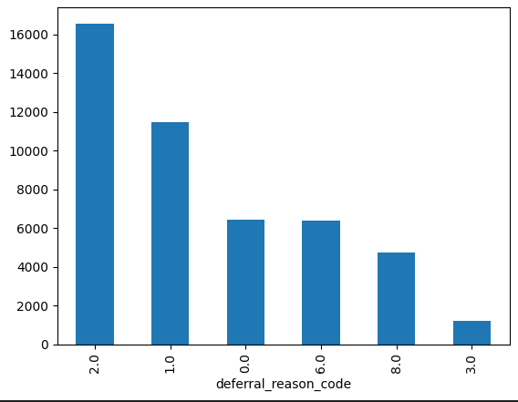
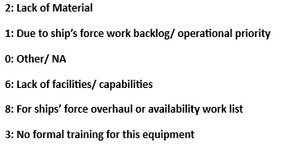
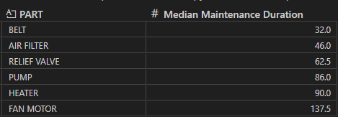
Data Analysis
Limited relationships between preexisting features and our intended response variable(s)
Recognized importance of techniques including:
Feature Engineering
Natural Language Processing (NLP) for text features

Slide 11
Predictive Modeling

Slide 12
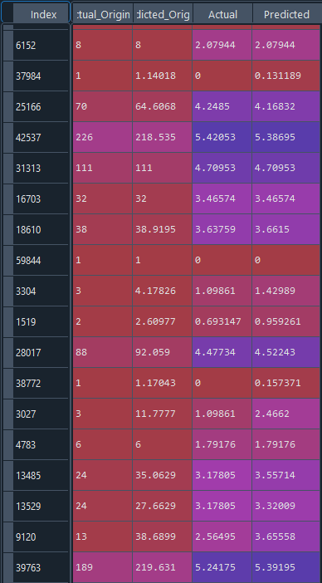
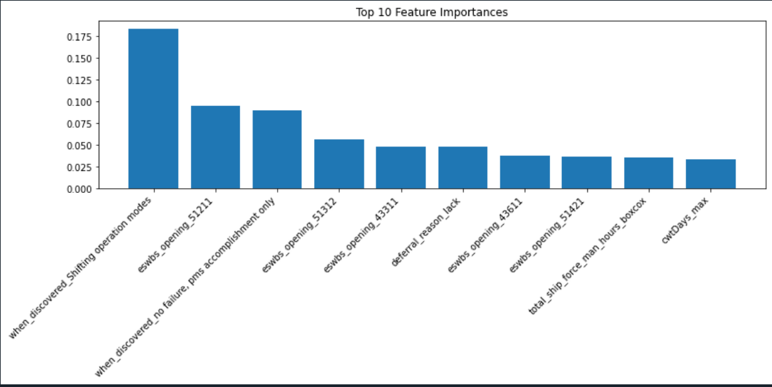
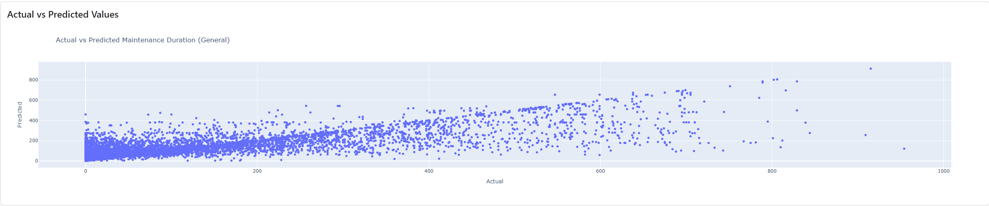
General Maintenance Duration Model
Model Overview
Algorithm: Random Forest
Handles high dimensionality and mixed data types well
Provides feature importance
Captures complex interactions between features
Robust against overfitting compared to individual decision trees
Slower to train and use compared to simpler methods
Less effective with linear relationships
Target Variable: Maintenance Duration (closing date – maintenance action date)
Features: 16 input features (mix of numeric categorical, and narrative)
Model Performance
R-Squared: 78%
Interpretation: 78% of the variation in predicted maintenance duration values is explained by the model
Error Measure: On average, predictions are off by about 63 days
Notes:
Handles high dimensionality and mixed data types well. This means it can work effectively with datasets that have many features and different types of variables.
Other algorithms like

Slide 13
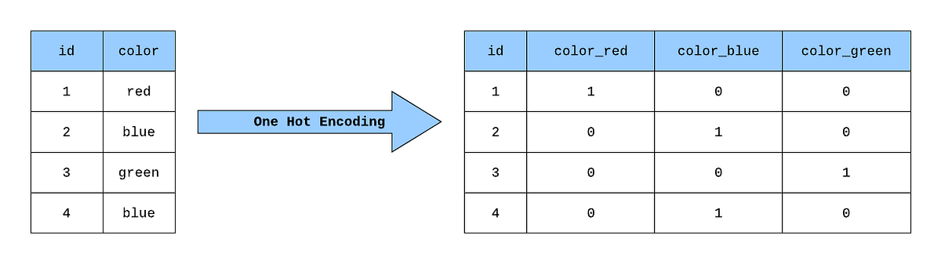
General Maintenance Duration Model- Continued
Approach
Stratified Sampling
Divided data into 5 homogenous groups
Stratified based on "Type of Maintenance Action" to ensure representative samples
Ensures model understands all kinds of maintenance tasks and significantly decreases runtime
Preprocessing
Standardization
Ensures features are all on a similar scale to prevent some factors from overpowering others
One-hot Encoding for Categorical Features
One-hot Encoding transforms categories into numbers to be easily read by the model
Hyperparameter Tuning
Finding the optimal configuration of settings for a machine learning model
Data Preparation
Stratified Sampling
Proprocessing
Random Forest Model
Hyperparameter Tuning
Hyperparameter Tuning
Model Training
Model Evaluation

Slide 14
PMS Models (Planned Maintenance System)
PMS Models vs General Models
PMS models focus specifically on planned maintenance actions
Designed to predict optimal maintenance times to prevent failures
Importance
Scheduling maintenance at the right time can minimize downtime
Resource optimization with fewer unexpected breakdowns
Maintenance can be scheduled during non-peak times
PMS Models
Maintenance Duration
Man Hours Opening
Man Hours Closing
Notes:
PMS models focus specifically on planned maintenance actions. Unlike general models that might include both planned and unplanned maintenance activities, PMS models are designed to predict the optimal maintenance times to prevent failures. This proactive approach ensures that maintenance is scheduled before issues arise, which in turn minimizes unexpected breakdowns.
With PMS models, we can predict the most suitable times for maintenance, ensuring that equipment is serviced before any failure occurs. This proactive scheduling helps in minimizing downtime, keeping operations running smoothly.
By predicting and preventing failures, PMS models help optimize the use of resources. This means fewer emergency repairs and better allocation of labor and materials, which ultimately leads to cost savings.
Another significant advantage of PMS models is the ability to plan maintenance activities during non-peak times. This ensures that operations remain efficient and uninterrupted.

Slide 15
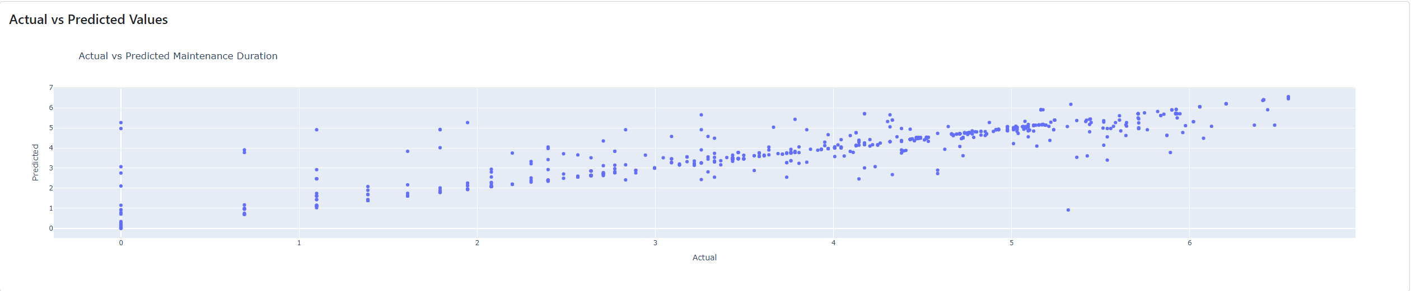
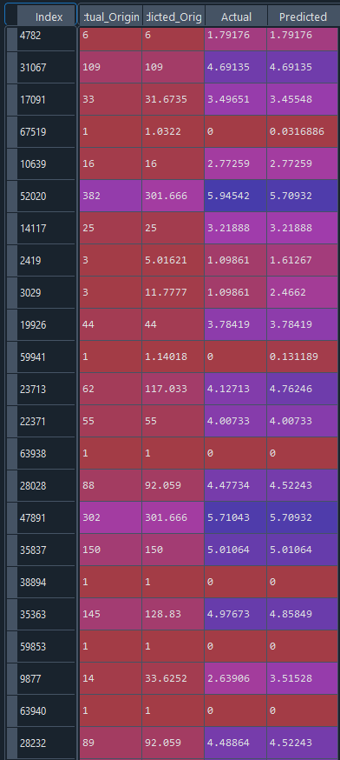
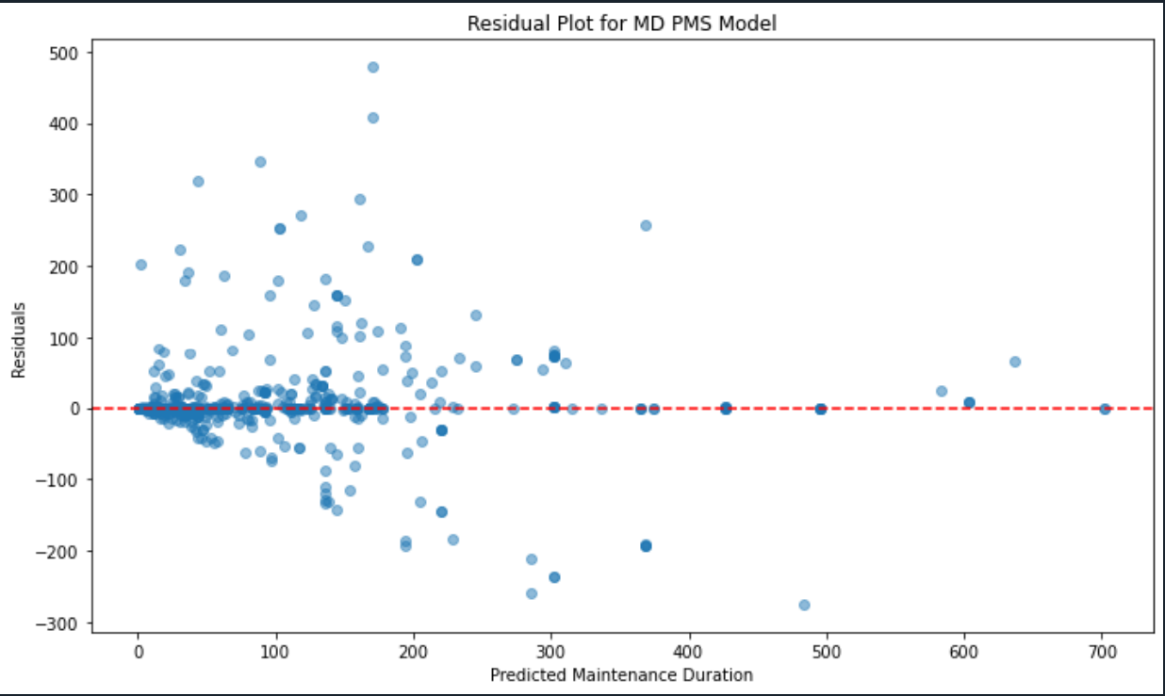
PMS Models
Maintenance Duration PMS Model
Algorithm: Random Forest
Target Variable: Maintenance Duration Subsetted by PMS
Features: 12 input features (mix of numeric, categorical, narrative)
Model Performance
R-Squared: .91
Error Measure: On average, predictions are off by about 20 days
Man Hours Opening PMS Model
R-Squared: .89
Interpretation: The model explains 89% of the variation in predicted maintenance duration values
Error Measure: On average, the model's predictions deviate from the actual MHO values by about 4.39 hours
Man Hours Closing PMS Model
R-Squared: .76
Interpretation: The model explains 76% of the variation in predicted maintenance duration values
Error Measure: On average, the model's predictions deviate from the actual MHO values by about 10 hours

Slide 16
Maintenance Duration PMS Model Demo
Column | Value
Expanded Ship Work Breakdown Structure | 51211
Availability Code | 4
Reason for Maintenance Deferral | due ship force work priority
Supply Quantity | 1
Days between Order and Receipt | 72
Total Material Cost (Log) | 3.3721
Fan Related Issue (1: related, 0: unrelated) | 0
Action Taken Code | 1
Discovery Description | no failure, pms accomplishment only
Filter related Issue (1:related, 0:unrelated | 0
Replacement Related Issue (1: related, 0: unrelated) | 1
Location Code 4 (Last Letter) | Q
Maintenance Duration | 152 Days

Slide 17
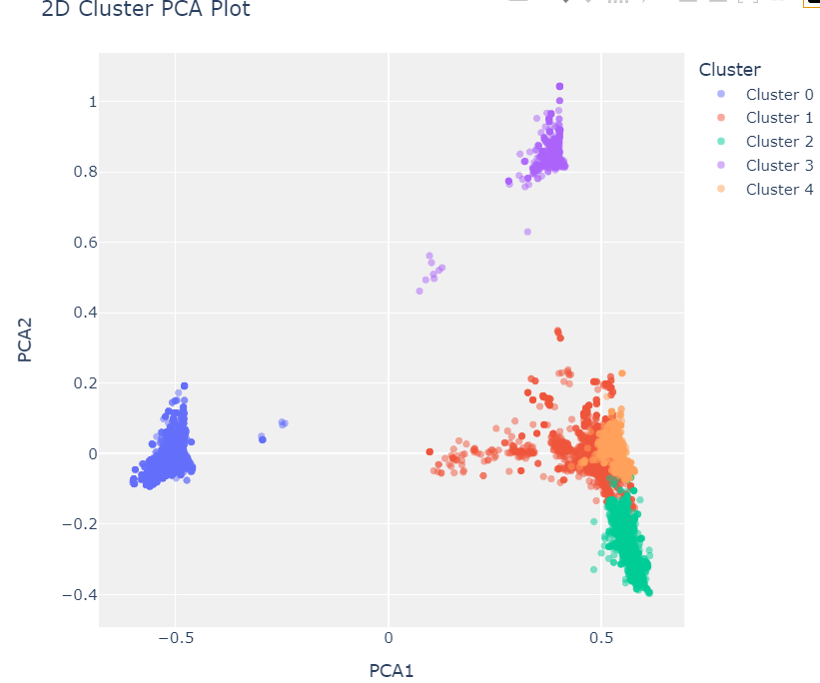
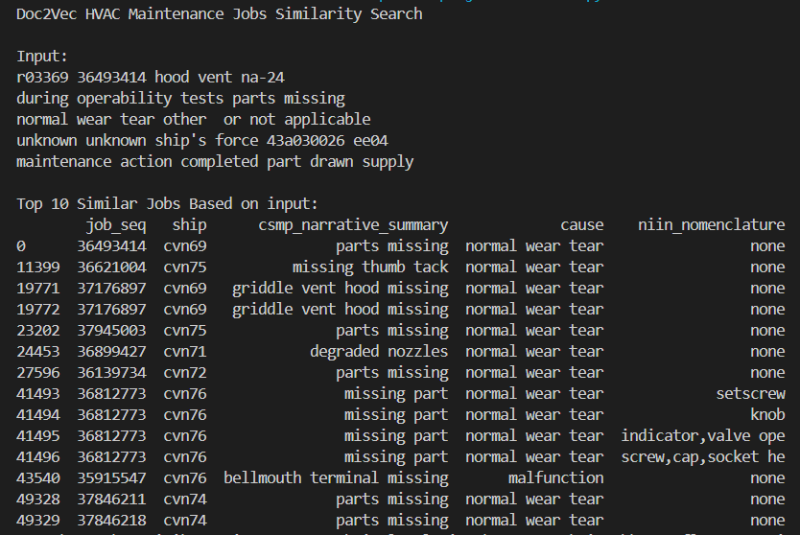
Other ML techniques used
K-means Clustering
Unsupervised machine learning that clusters data points into the same categories
To overcome barrier of lacking ground truth (let the data categorize itself)
Benefit: Better insight and understanding in the nature of the data and HVAC systems
Doc2Vec Model
Explored potential in harnessing the model to enhance the search capabilities of HVAC jobs data
Principle: Similar jobs will have similar vector representations
Benefit: Searching similar jobs from the past can help problem-solve future jobs

Slide 18
Custom Named Entity Recognition (NER) Model
Allows us to extract information from narrative columns that can be interpreted by a Machine Learning model as a categorical feature
Identifies entities within a free form text column
Engineered PART and CONDITION column using NER results

Slide 19
Takeaway Value
Random Forest Model Predicting Maintenance Duration
Data-driven insights relevant to planning/ scheduling new maintenance actions
Improved resource and personnel allocation
Interactive Dashboard
Concise and easily interpretable summaries for maintenance jobs of interest

Slide 20
Skills/Techniques Learned
Jeff
Natural Language Processing (NLP) Techniques including Named Entity Recognition (NER) and the Word2Vec algorithm
Feature Engineering and Data Preprocessing
Jason
Real-world datasets and learning how to create machine learning models
Essential teamwork skills and data wrangling/cleaning
Rica
Experience developing a data science solution pipeline to satisfy a business need
Developing a dashboard for effective data visualization
Experience working with real-world datasets (complex, messy)

Slide 21
Questions?

